Slide 1

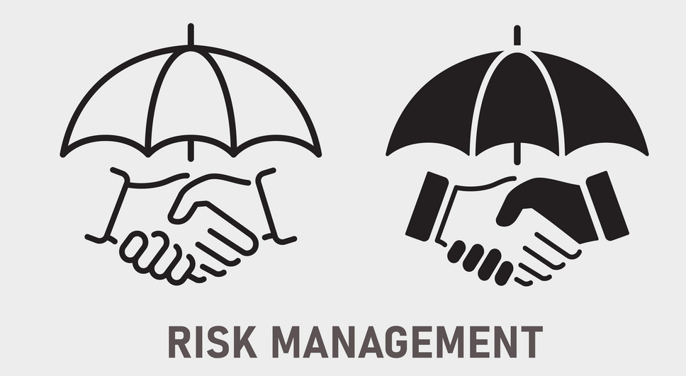
RISK MANAGEMENT
RISK MANAGEMENT IN AN ORGANISATION.

Slide 2

ABSTRACT
Risk management is a structured approach/methodology for managing uncertainty related to threats.
A series of human activities including in Risk management are;
Risk monitoring
Risk mitigation
Risk management
Developing strategies to manage it and risk mitigation using resource empowerment/management

Slide 3

INTRODUCTION
The following steps that are include in risk assessment are;
Identify Risks – If you can think of it you can prevent it
Prioritize Risks
Analyse Risk Response Strategies
Plan Risk Response
Monitor and Control Risks

Slide 4

Objectives of the risk management
The main theme of the Risk management is to control and mitigate the risk that are getting in an organistaion

Slide 5
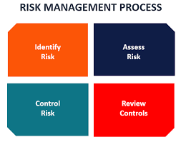
Hence from the risk management the main objectives for the risk management are;
Reduce and Eliminate Harmful Threats
Supports Efficient use of Resources
Better Communication of Risk within Organization
Reassures Stakeholders
When the potential risks are identified, measured, and monitored
then the final objective is to find out ways to deal with or control those risks.

Slide 6
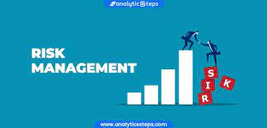
Importance of Risk management Risk management is an important process. Because it empowers a business with the necessary tools so that it can adequately identify and deal with potential risks .Once a risk has been identified, it is then easy to mitigate it. In addition, risk management provides a business with a basis upon, which it can undertake sound decision making.

Slide 7
Literature Review
Shahroudi et al (2012)- journal of effective risk management
Shahroudi et al 2012 in support confirmed that reducing exposed risk increase quality of service as well as firms and financial performance, they added that risk management and financial performance has a positive relationship. they revealed that firms with a reputable risk reduction practice produce more revenue and their risk maturity got linked with better return on asset and positive response on risk management.
Pac 2015- journal of strategic management
The pac2015 is about the management that lack of risk reduction has been evidenced by the recurring of observations of every year. However it most done on empirical studies on effects on risk management on performances had been done mostly in developed countries and in insurance companies in Kenya. Now a days it is a imp research topic many in business and industrial areas

Slide 8
Feririo 2020-Journal of modern transportation
Feririo 2020 is the risk management review on driverless cars, feririo 2020 is the risk mangement that provided on the driverless cars in 2020 that they are becoming important note readly in society .Driverless cars rely on sensors and a complex system in order to function. However, by the technology it overcome with the driverless feature.
La and choi 2012-Jouranl of methodology of supply chain
La and choi are the two persons on risk management that has a positive significant relationship with organisational performance, Wanjohi agreed that risk management has a significant and positive relationship between financial performance of an organization. However, they posted there will be weak responses for our management also. But however, it will if there are strong decision in our management no matter occur whether it is right or wrong.

Slide 9

Methodologies
Risk assessments can be either of two types:
Quantitative
Qualitative.
Quantitative risk refers to the numerical value of the probability and potential impact of a threat. This type of risk assessment requires data collection and statistical analysis to arrive at those numbers.
Qualitative risk is more subjective, focusing on the characteristics of a threat rather than its numerical value. This type of risk assessment often uses expert opinion to arrive at ratings (usually a low/medium/high scale or something similar) for probability and potential impact.
Hence these are the types of methodologies that are performed during a risk management.

Slide 10
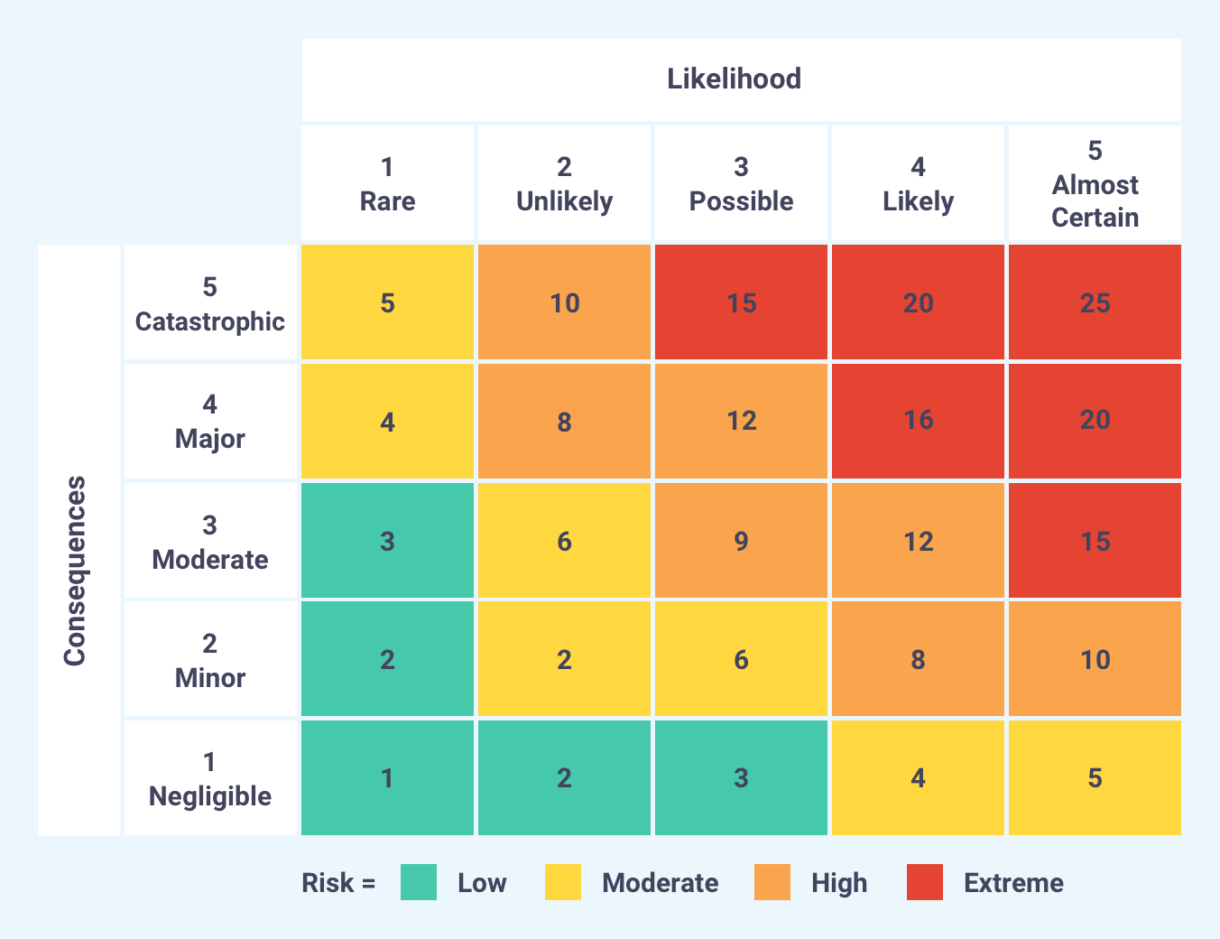
Quantative risk analysis

Slide 11
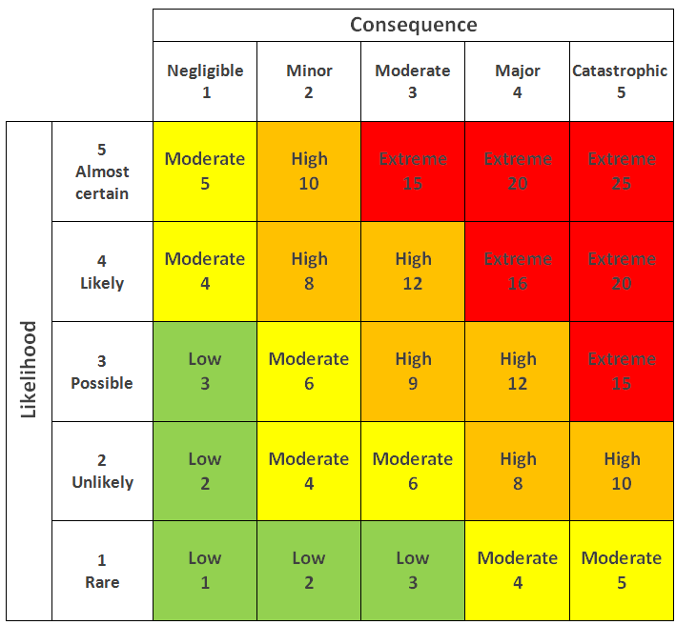
Qualitative risk analysis

Slide 12
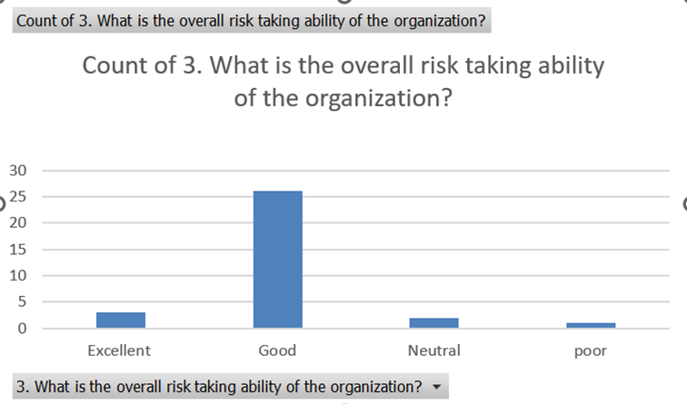
Data Analysis From the above graph ,we came an decision that the risk management performance is good during the risk managing in an organistaion.

Slide 13
Future enhancement in risk management
Designing the next generation controls operating model - reimagining the key principles of the operating model and the enablers that can help change mindsets, develop capabilities, and assist businesses to embrace, operate, and embed controls as part of the organization’s DNA
Reconstructing the internal controls framework - building a true data-driven agile framework that mitigates known risks, anticipates and apprises the organization to emerging risks, delivers value, and drives focus
Establishing the controls technology ecosystem - leveraging the digital transformation and utilizing controls automation to help alleviate some of the pressure on the internal controls functions in cost reduction, efficiency drive, and effective management of risks and opportunities. And at the same time building confidence, intelligence, and performance—three key elements of a successful FoC journey
We explore these levers in detail and provide examples from global organizations that demonstrate the trends and successful business engagements that help achieve the Future of Controls vision.

Slide 14
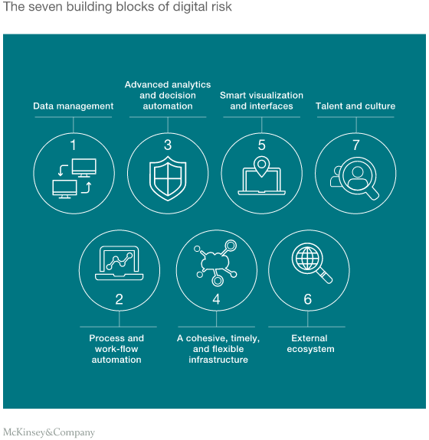
Steps in the risk management in the future era is,

Slide 15
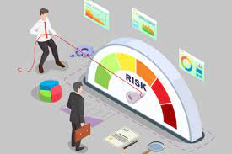
Advantages of Risk management
See risks that are not apparent. ...
Provide insights and support to the Board of Directors. ...
Get credit for cooperation. ...
Build a better defense to class-actions. ...
Reduce business liability. ...
Frame regulatory issues.

Slide 16

Disadvantages of Risk management
Not Suitable For All Organizations. ...
Expensive. ...
Training Costs. ...
Loss of Focus Due to Automation. ...
Data Security Issue. ...
Authorship/Referencing - About the Author(s)

Slide 17

Conclusion
Risk management is an important process that
Managers should maintain in an organization.
It is inevitable to have risks and managers should
have better strategies to deal with risks. The long-term
survival of an organization depends on the ability to manage
risks. The intensifying competition in the global markets has
forced managers to focus on maintaining a strong risks
management program by establishing values

Slide 18

References
Ali, Mashhud. 2006. Risk Management. Jakarta: PT Raja Grafindo Persada.
AS/NZS 4360:2004, Australian/New Zealand Standard Risk Management, Joint Technical Committee OB-007 Risk Management, 31 Agustus 2004.
Committee of Sponsoring Organization (COSO) of the Treadway Commission. What is COSO: Background and Events Leading to Internal Control-Integrated Framework. 1992.
Chapman, Christy. Bringing ERM into Focus. Internal Auditor, June 2003.
Darmawi, Herman. Risk Management. Bumi Aksara, 2005.
Djojosoedarso, Soeisno. Principles of risk and insurance management. 1999.
Iban, Sofyan. 2004. Risk Management. Jakarta: Graha Ilmu.

Slide 19




Thank You
K.Sai Sanjana &A.Jahnavi
192011124 &192110065
Principles of management

